Slide 1

Magnetosheath jet generation due to shock reformation Savvas Raptis Division of Space and Plasma Physics, KTH Royal Institute of Technology, Sweden MMS SWT Tag-up Tuesday 25/01/2022

Slide 2
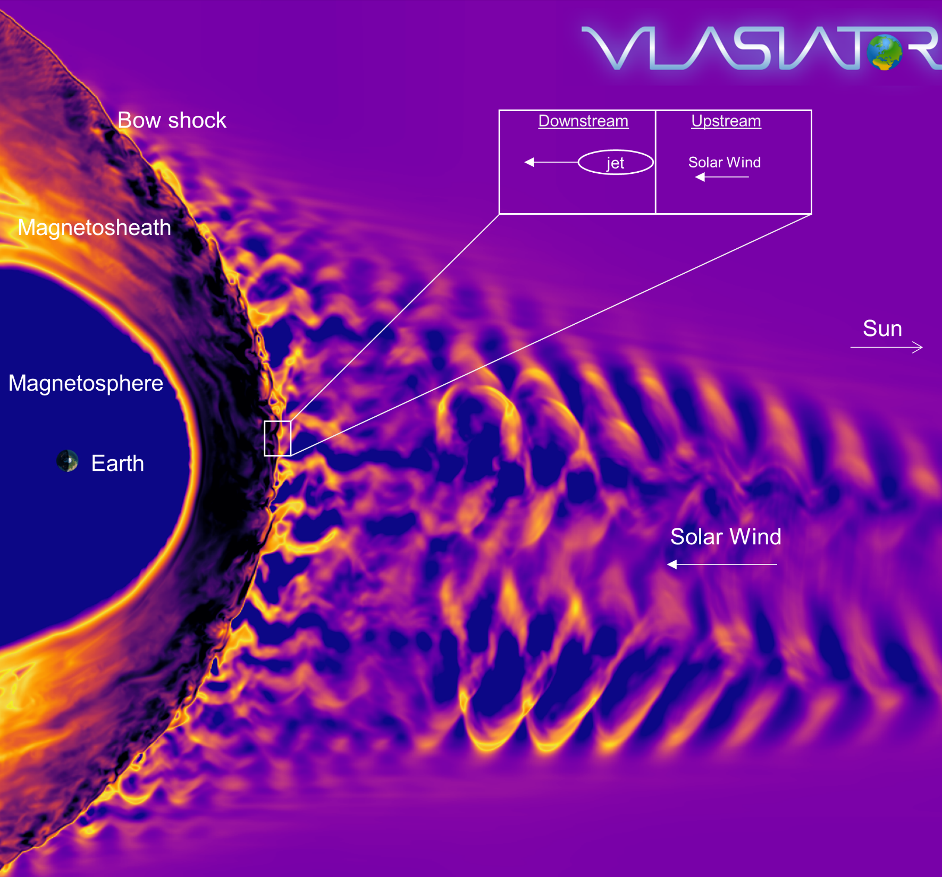
Earth’s magnetosphere
Courtesy of M. Palmroth, U Helsinki

Slide 3
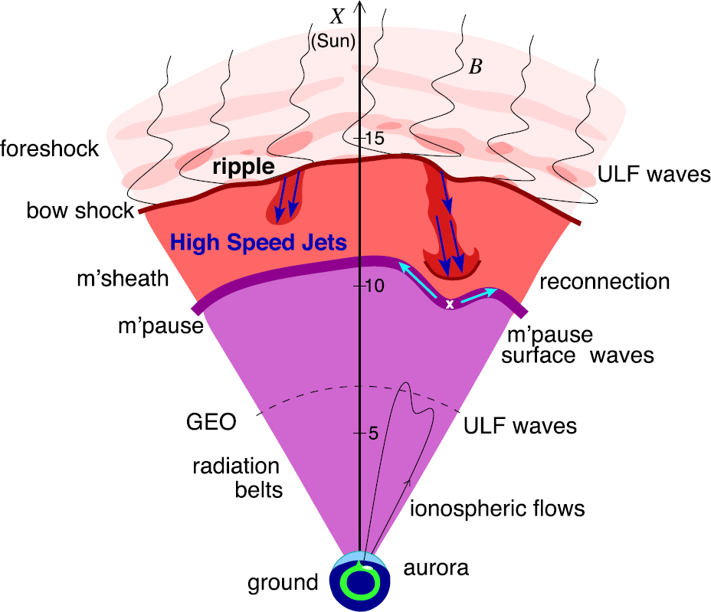
Magnetosheath Jets
Definition
Magnetosheath jets are transient localized enhancements of dynamic pressure (density and/or velocity increase)
e.g. 200% dynamic pressure enhancement compared to background magnetosheath
Related phenomena
Radiation belts
Aurora
Magnetopause reconnection
Magnetopause penetration
Shock acceleration
Magnetopause surface eigenmodes
ULF waves
Plaschke F. et al. (2018); sketch by H. Hietala | Space Sci. Rev

Slide 4
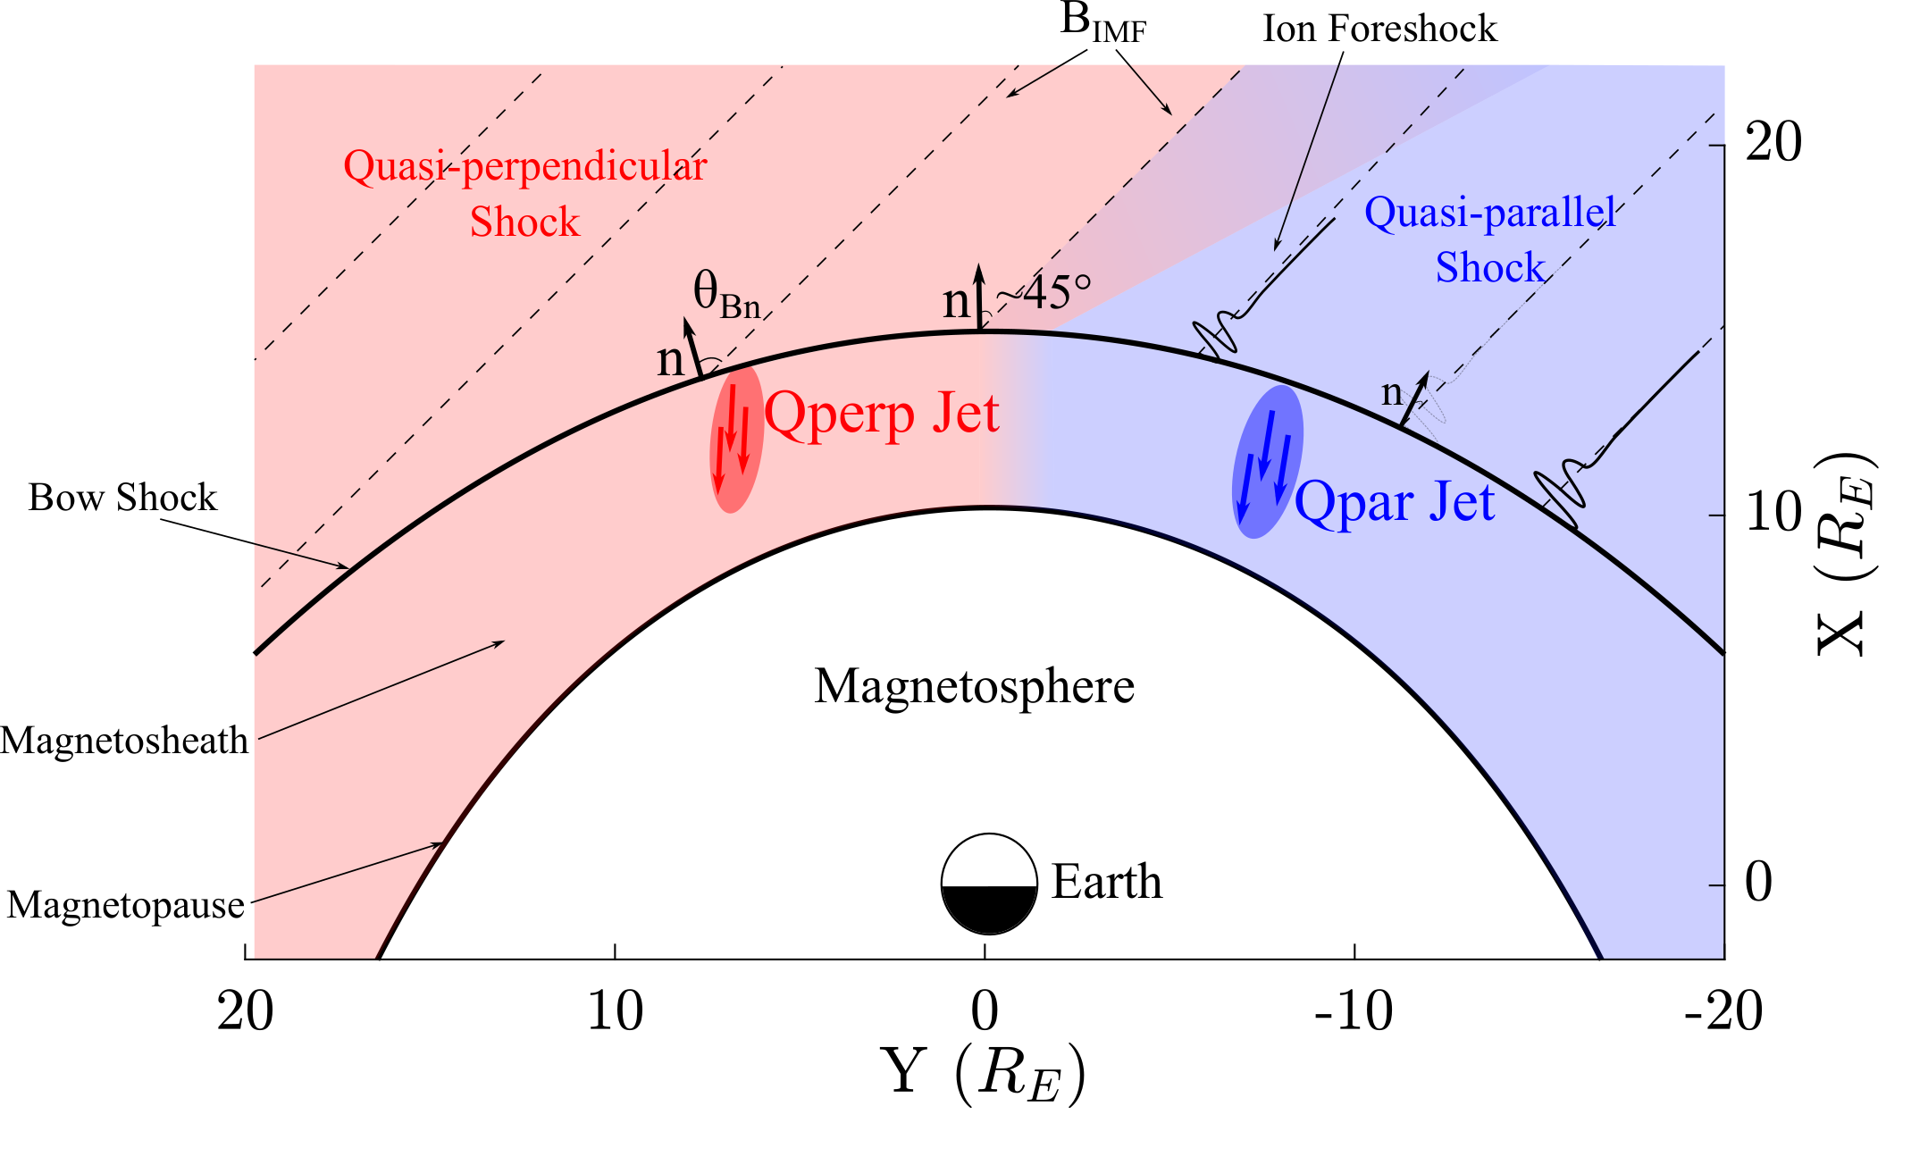
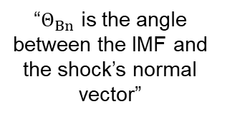
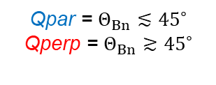
Shock, Magnetosheath & Jet classification
“$Θ_{Βn}$ is the angle between the IMF and the shock’s normal vector”
Qpar = $Θ_{Βn}≲{45}^{∘}$
Qperp = $Θ_{Βn}≳{45}^{∘}$
”Jets found ~9 times more often in the Qpar MSH”
Raptis, Karlsson, et al. (2020) | JGR
Raptis, Aminalragia-Giamini et al. (2020) | Front. Astron. Space Sci
Karlsson, Raptis S., et al. (2021) | JGR
Kajdič, Raptis et al. (2021) | GRL

Slide 5
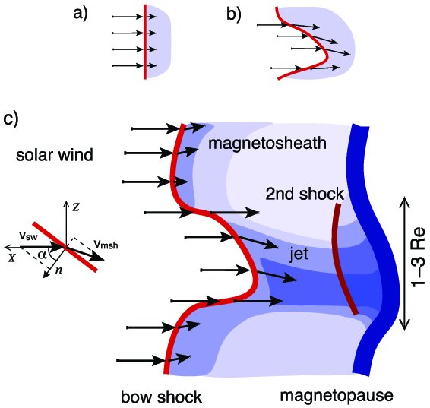
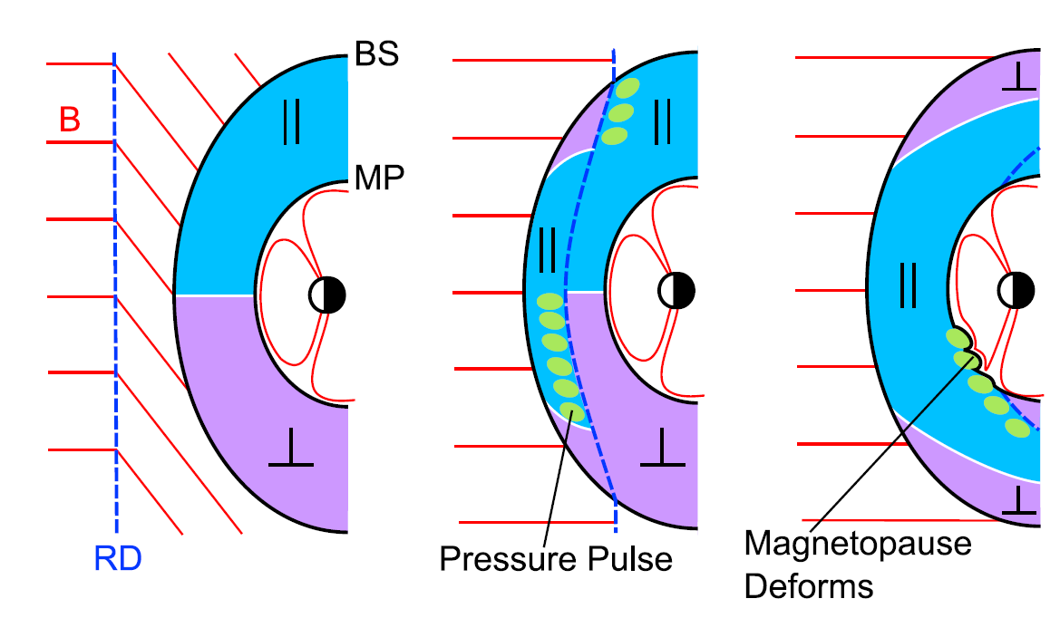
How are these jets created ?
Shock ripples
SW discontinuities
Foreshock Structures
Hietala et al. (2009,2012)
Archer et al. (2012)
Suni et al. (2021), Raptis et al. (2022)

Slide 6
Recent Results

Slide 7
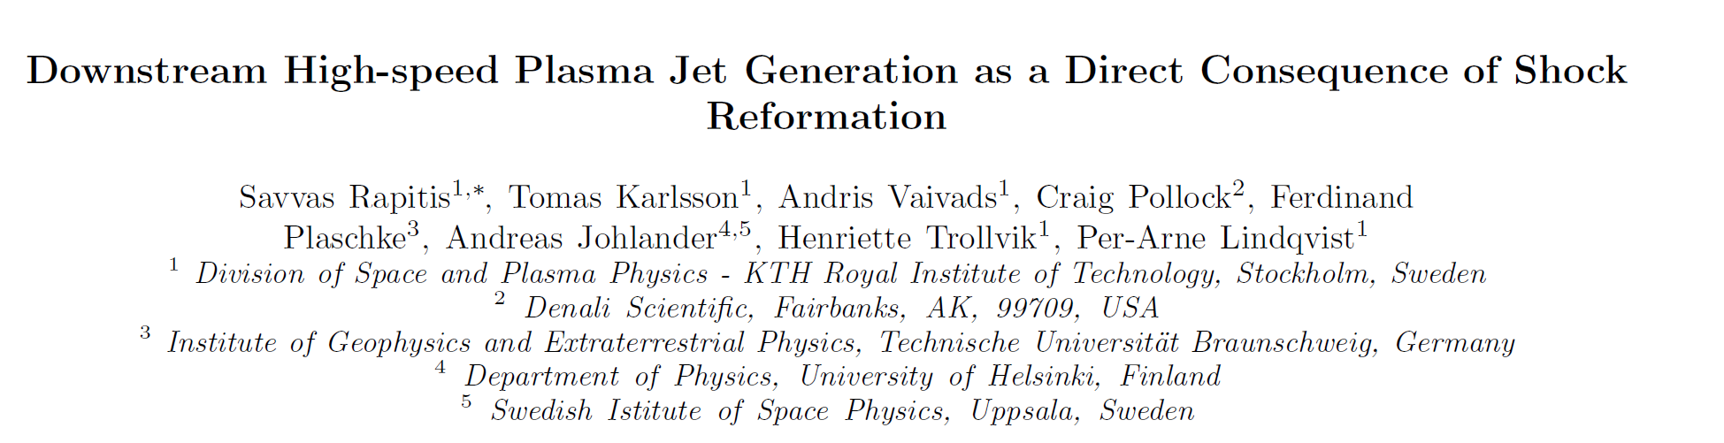
Raptis et al. (2022) “Downstream High-speed Plasma Jet Generation as a Direct Consequence of Shock Reformation”, Nature Communications (accepted)

Slide 8
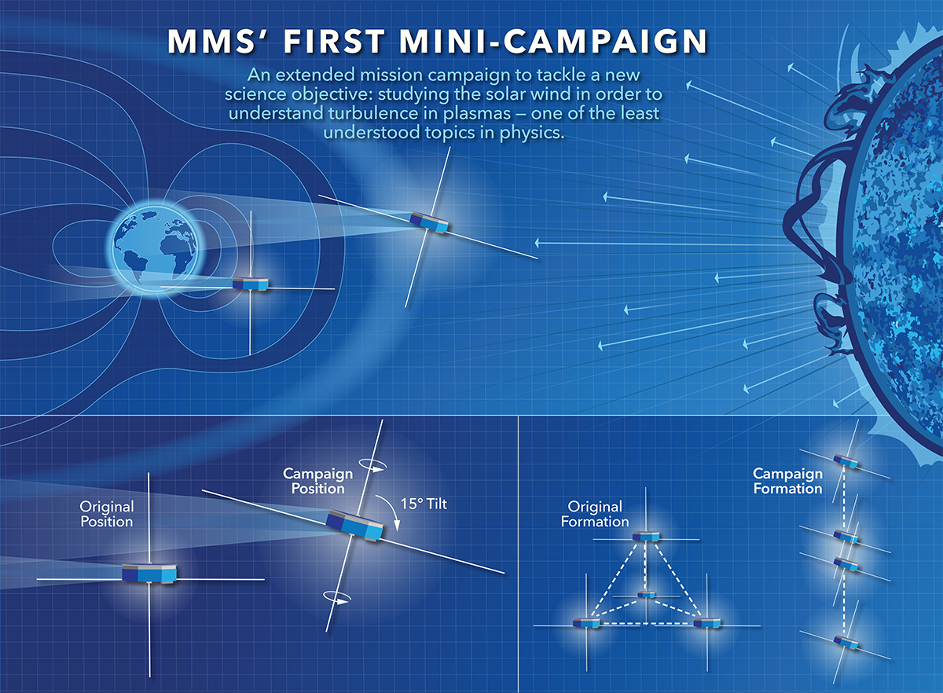
MMS spacecraft + String of Pearl Configuration
Credits: NASA's Goddard Space Flight Center/Mary Pat Hrybyk-Keith

Slide 9
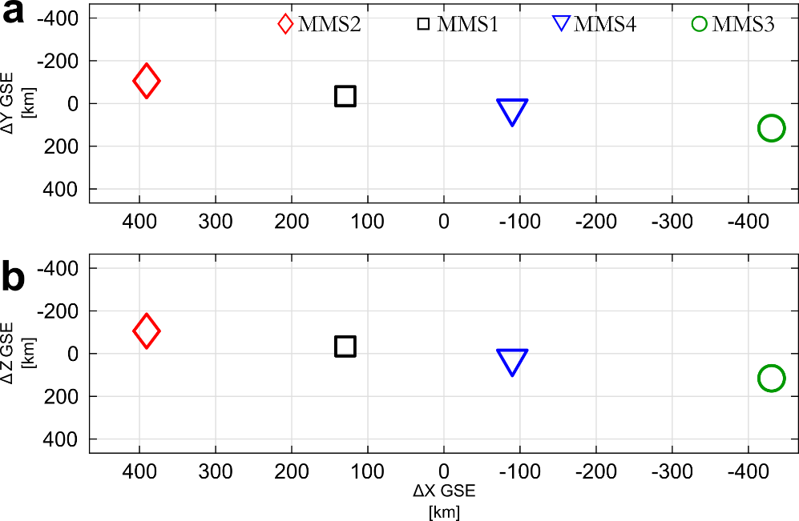
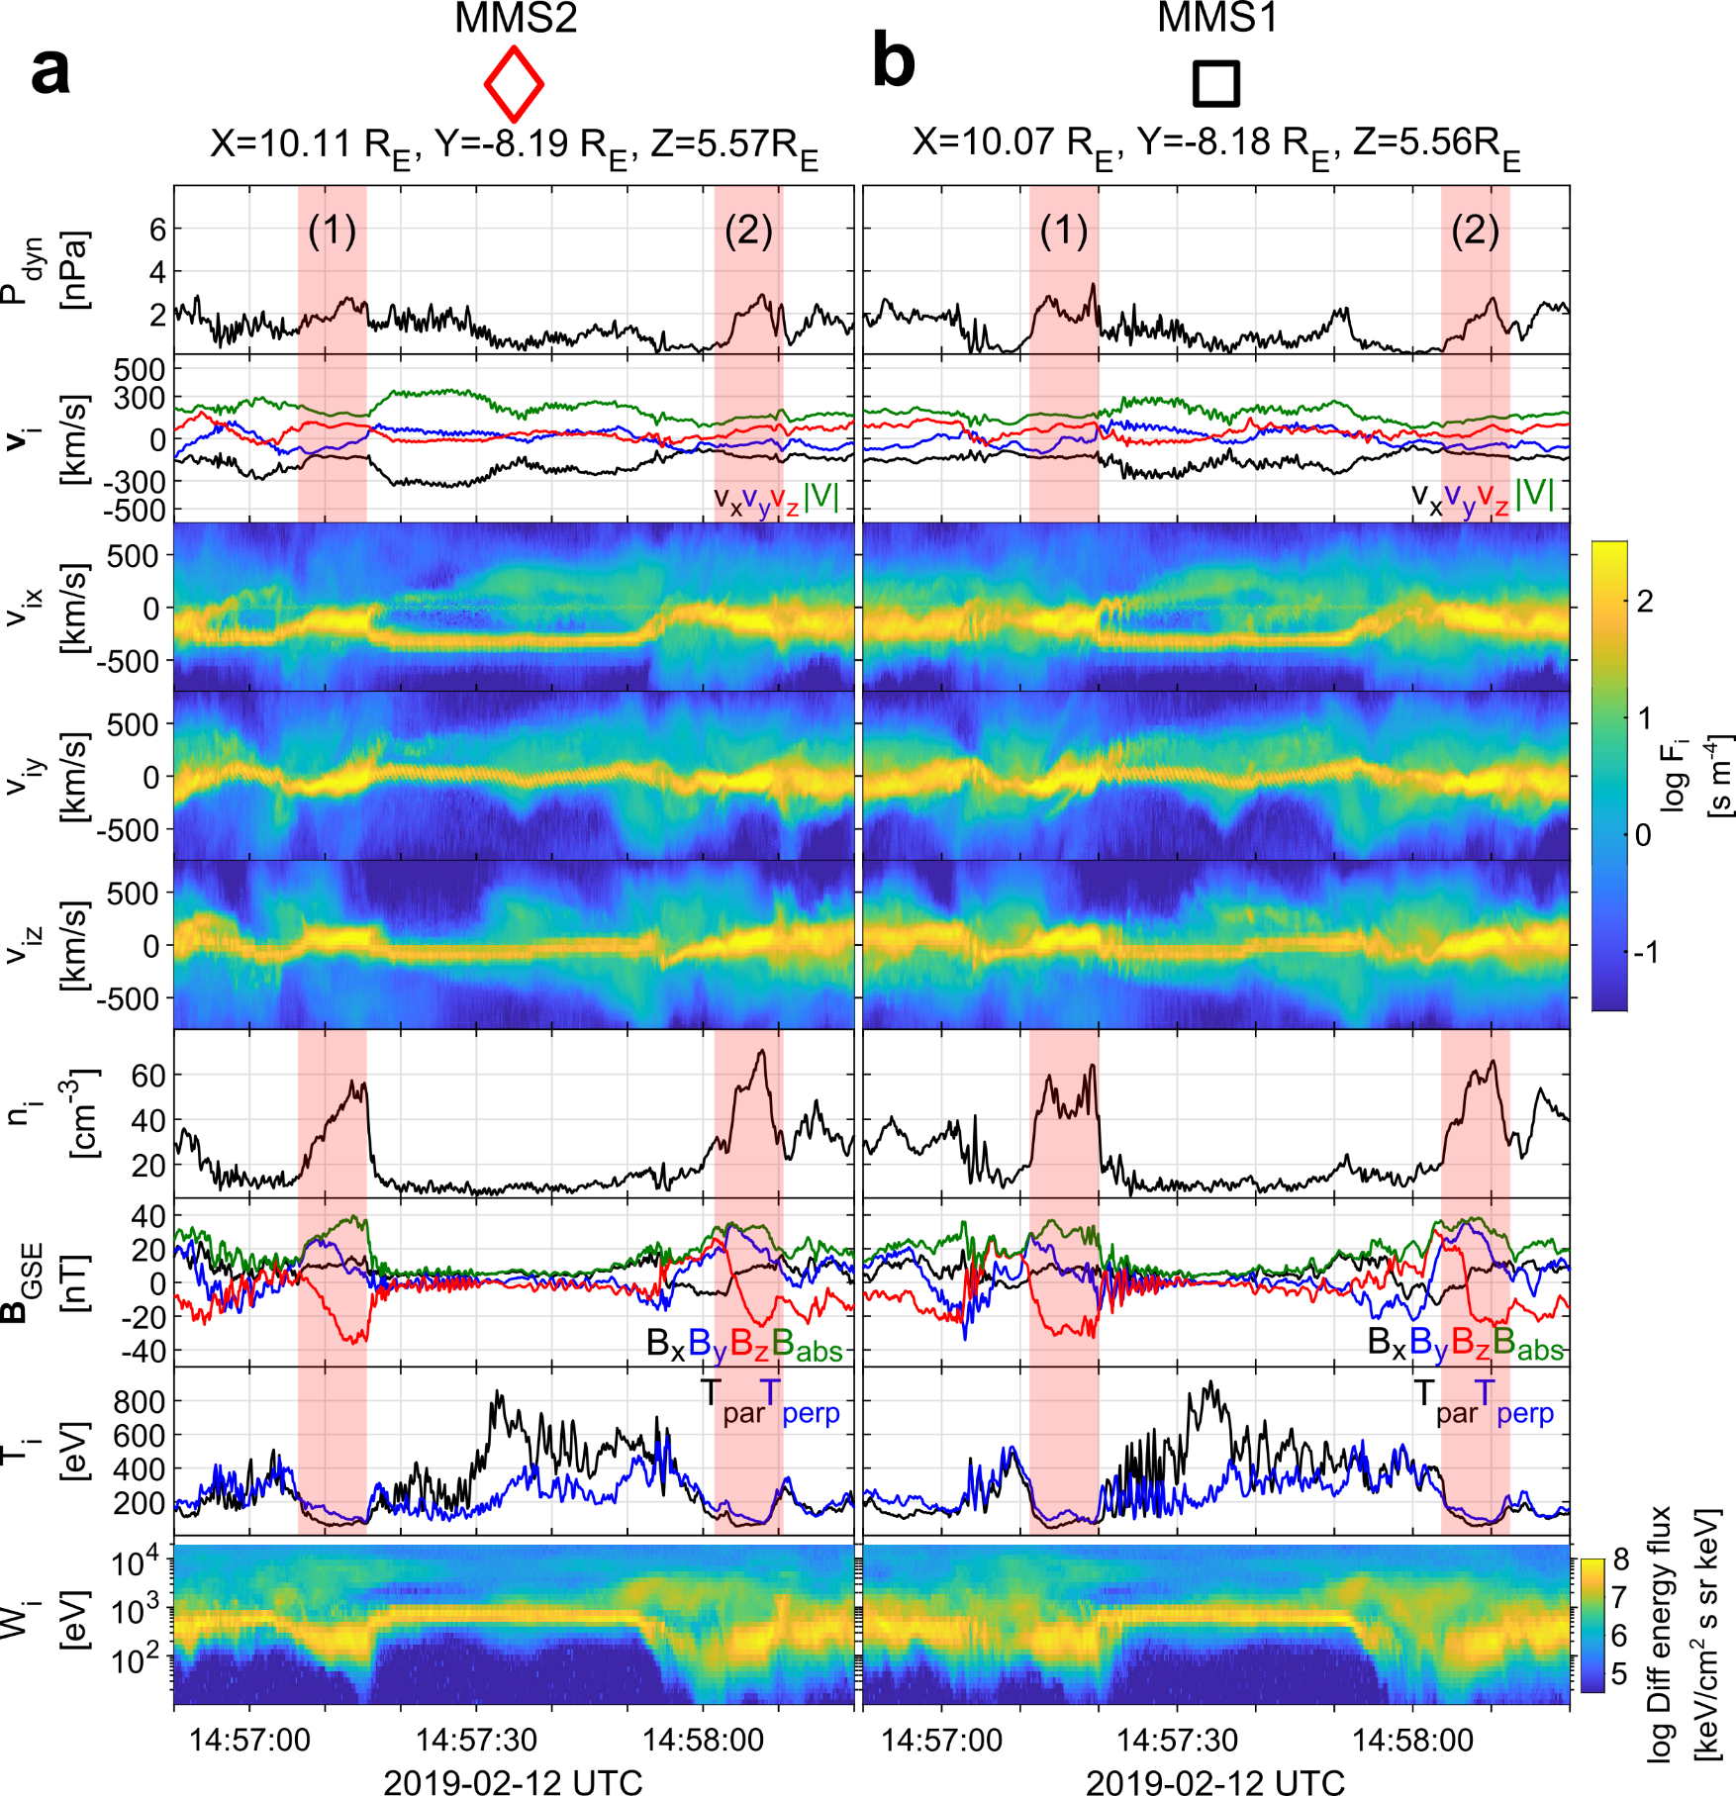
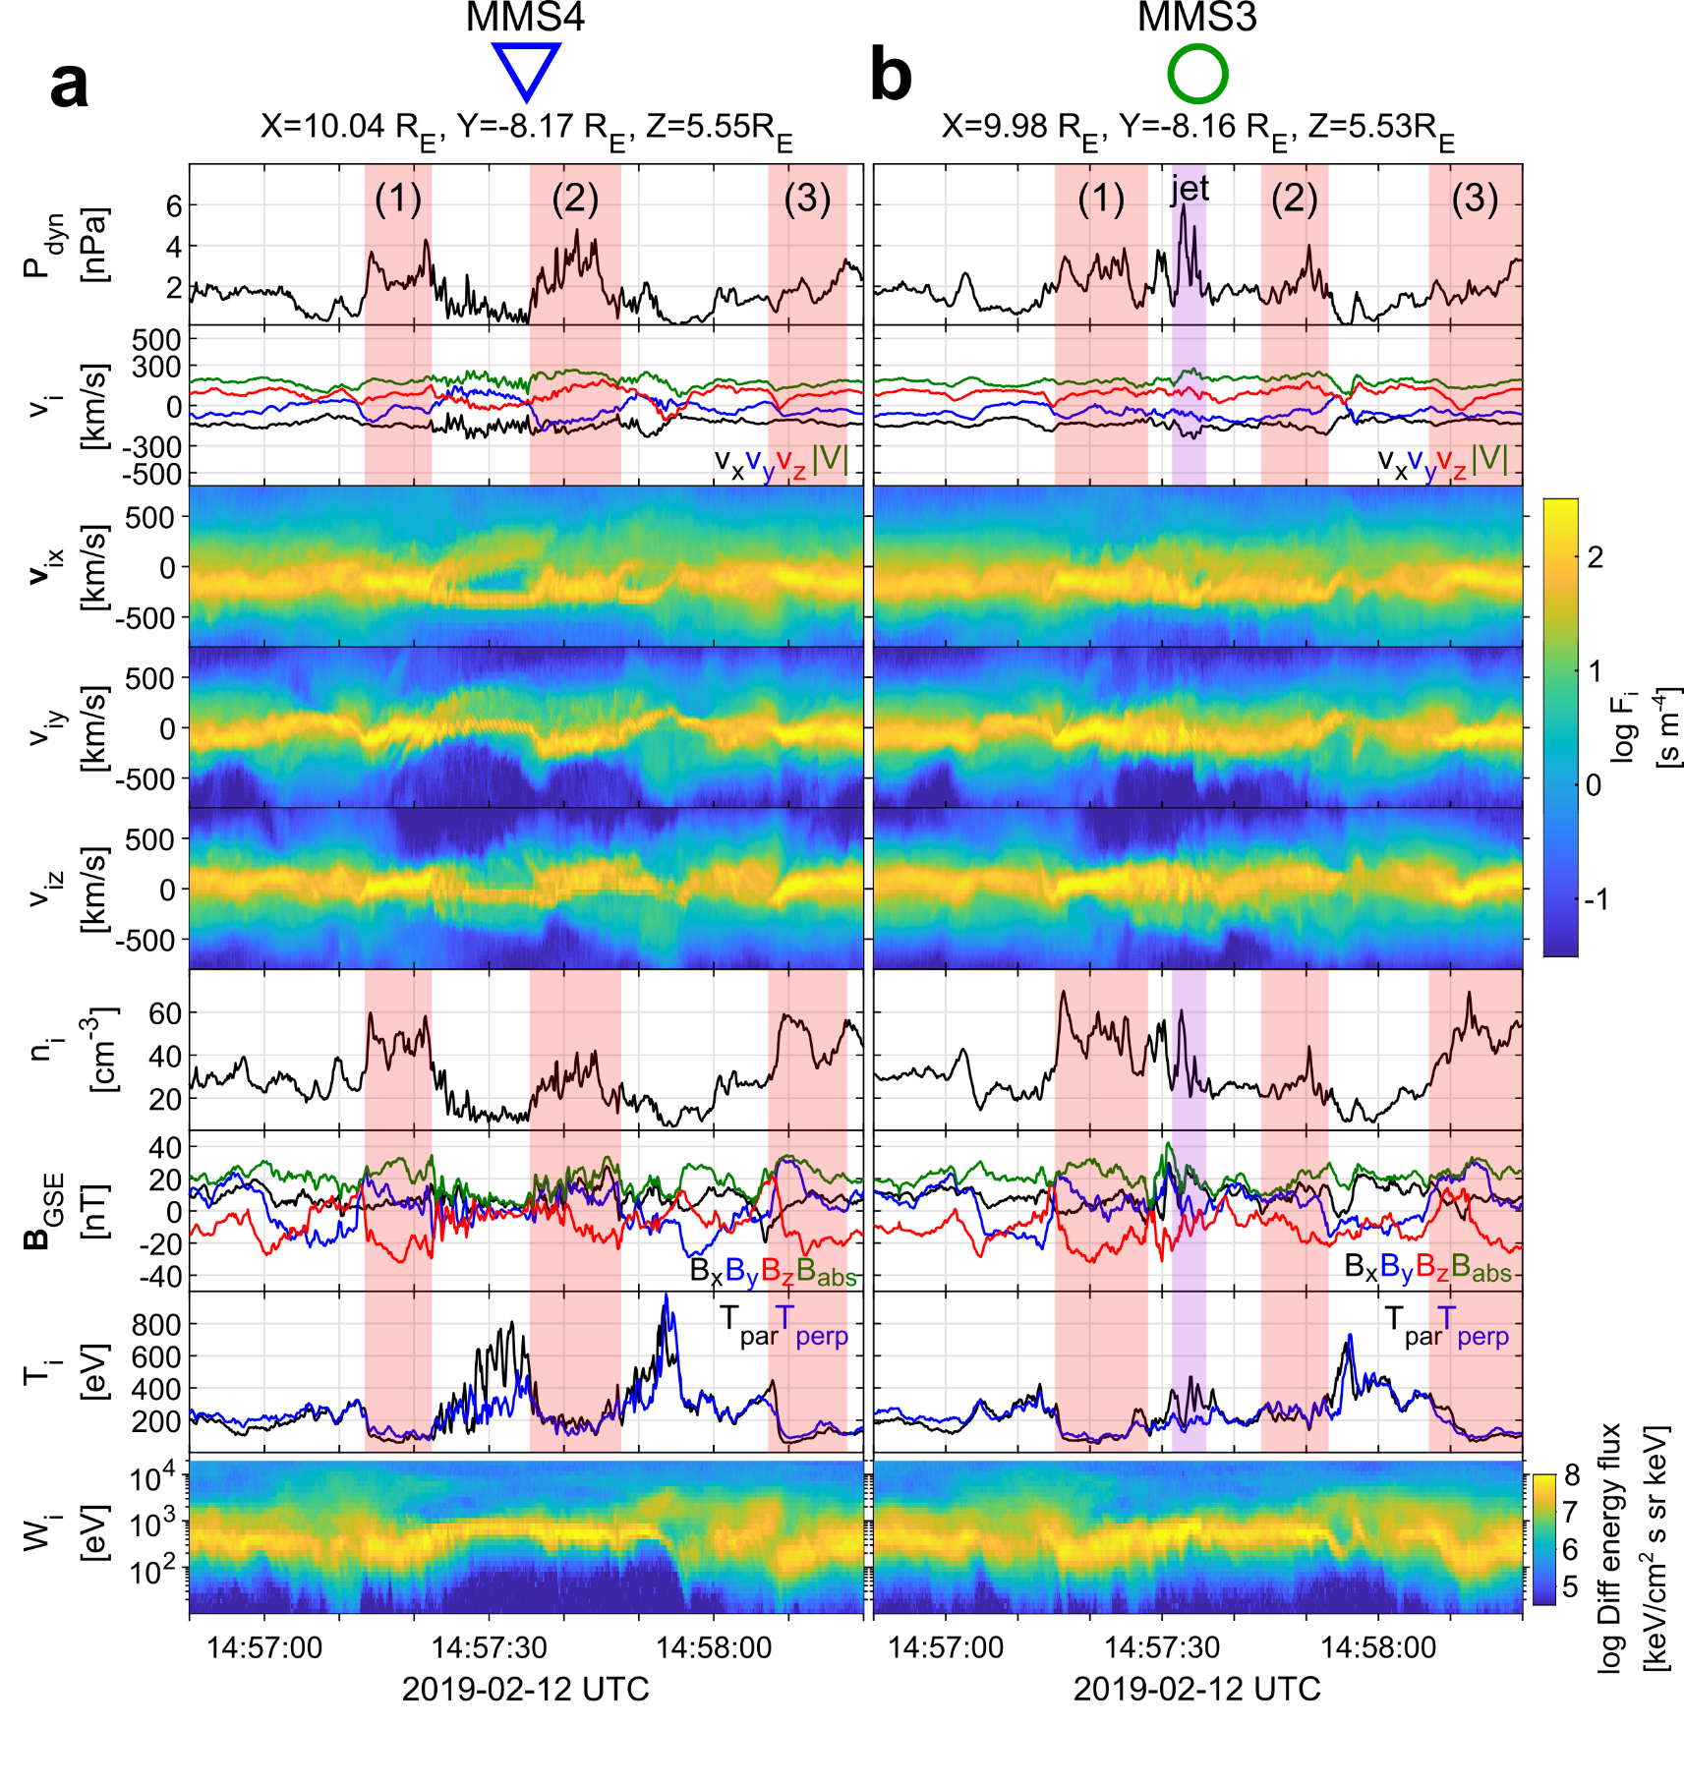
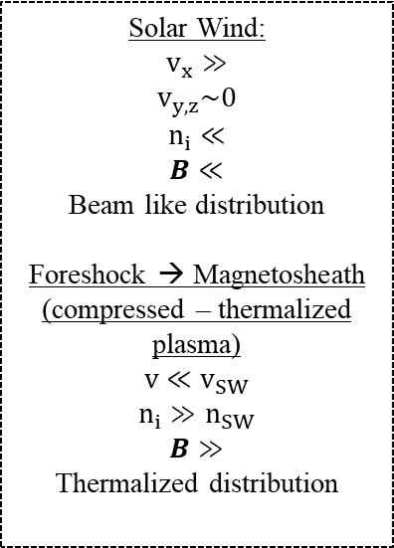
General Observations of MMS
Solar Wind:
$$v_{x}≫$$
$$v_{y,z}\sim 0$$
$$n_{i}≪$$
$$B≪$$
Beam like distribution
Foreshock → Magnetosheath
(compressed – thermalized plasma)
$$v≪v_{SW}$$
$$n_{i}≫n_{SW}$$
$$B≫$$
Thermalized distribution

Slide 10
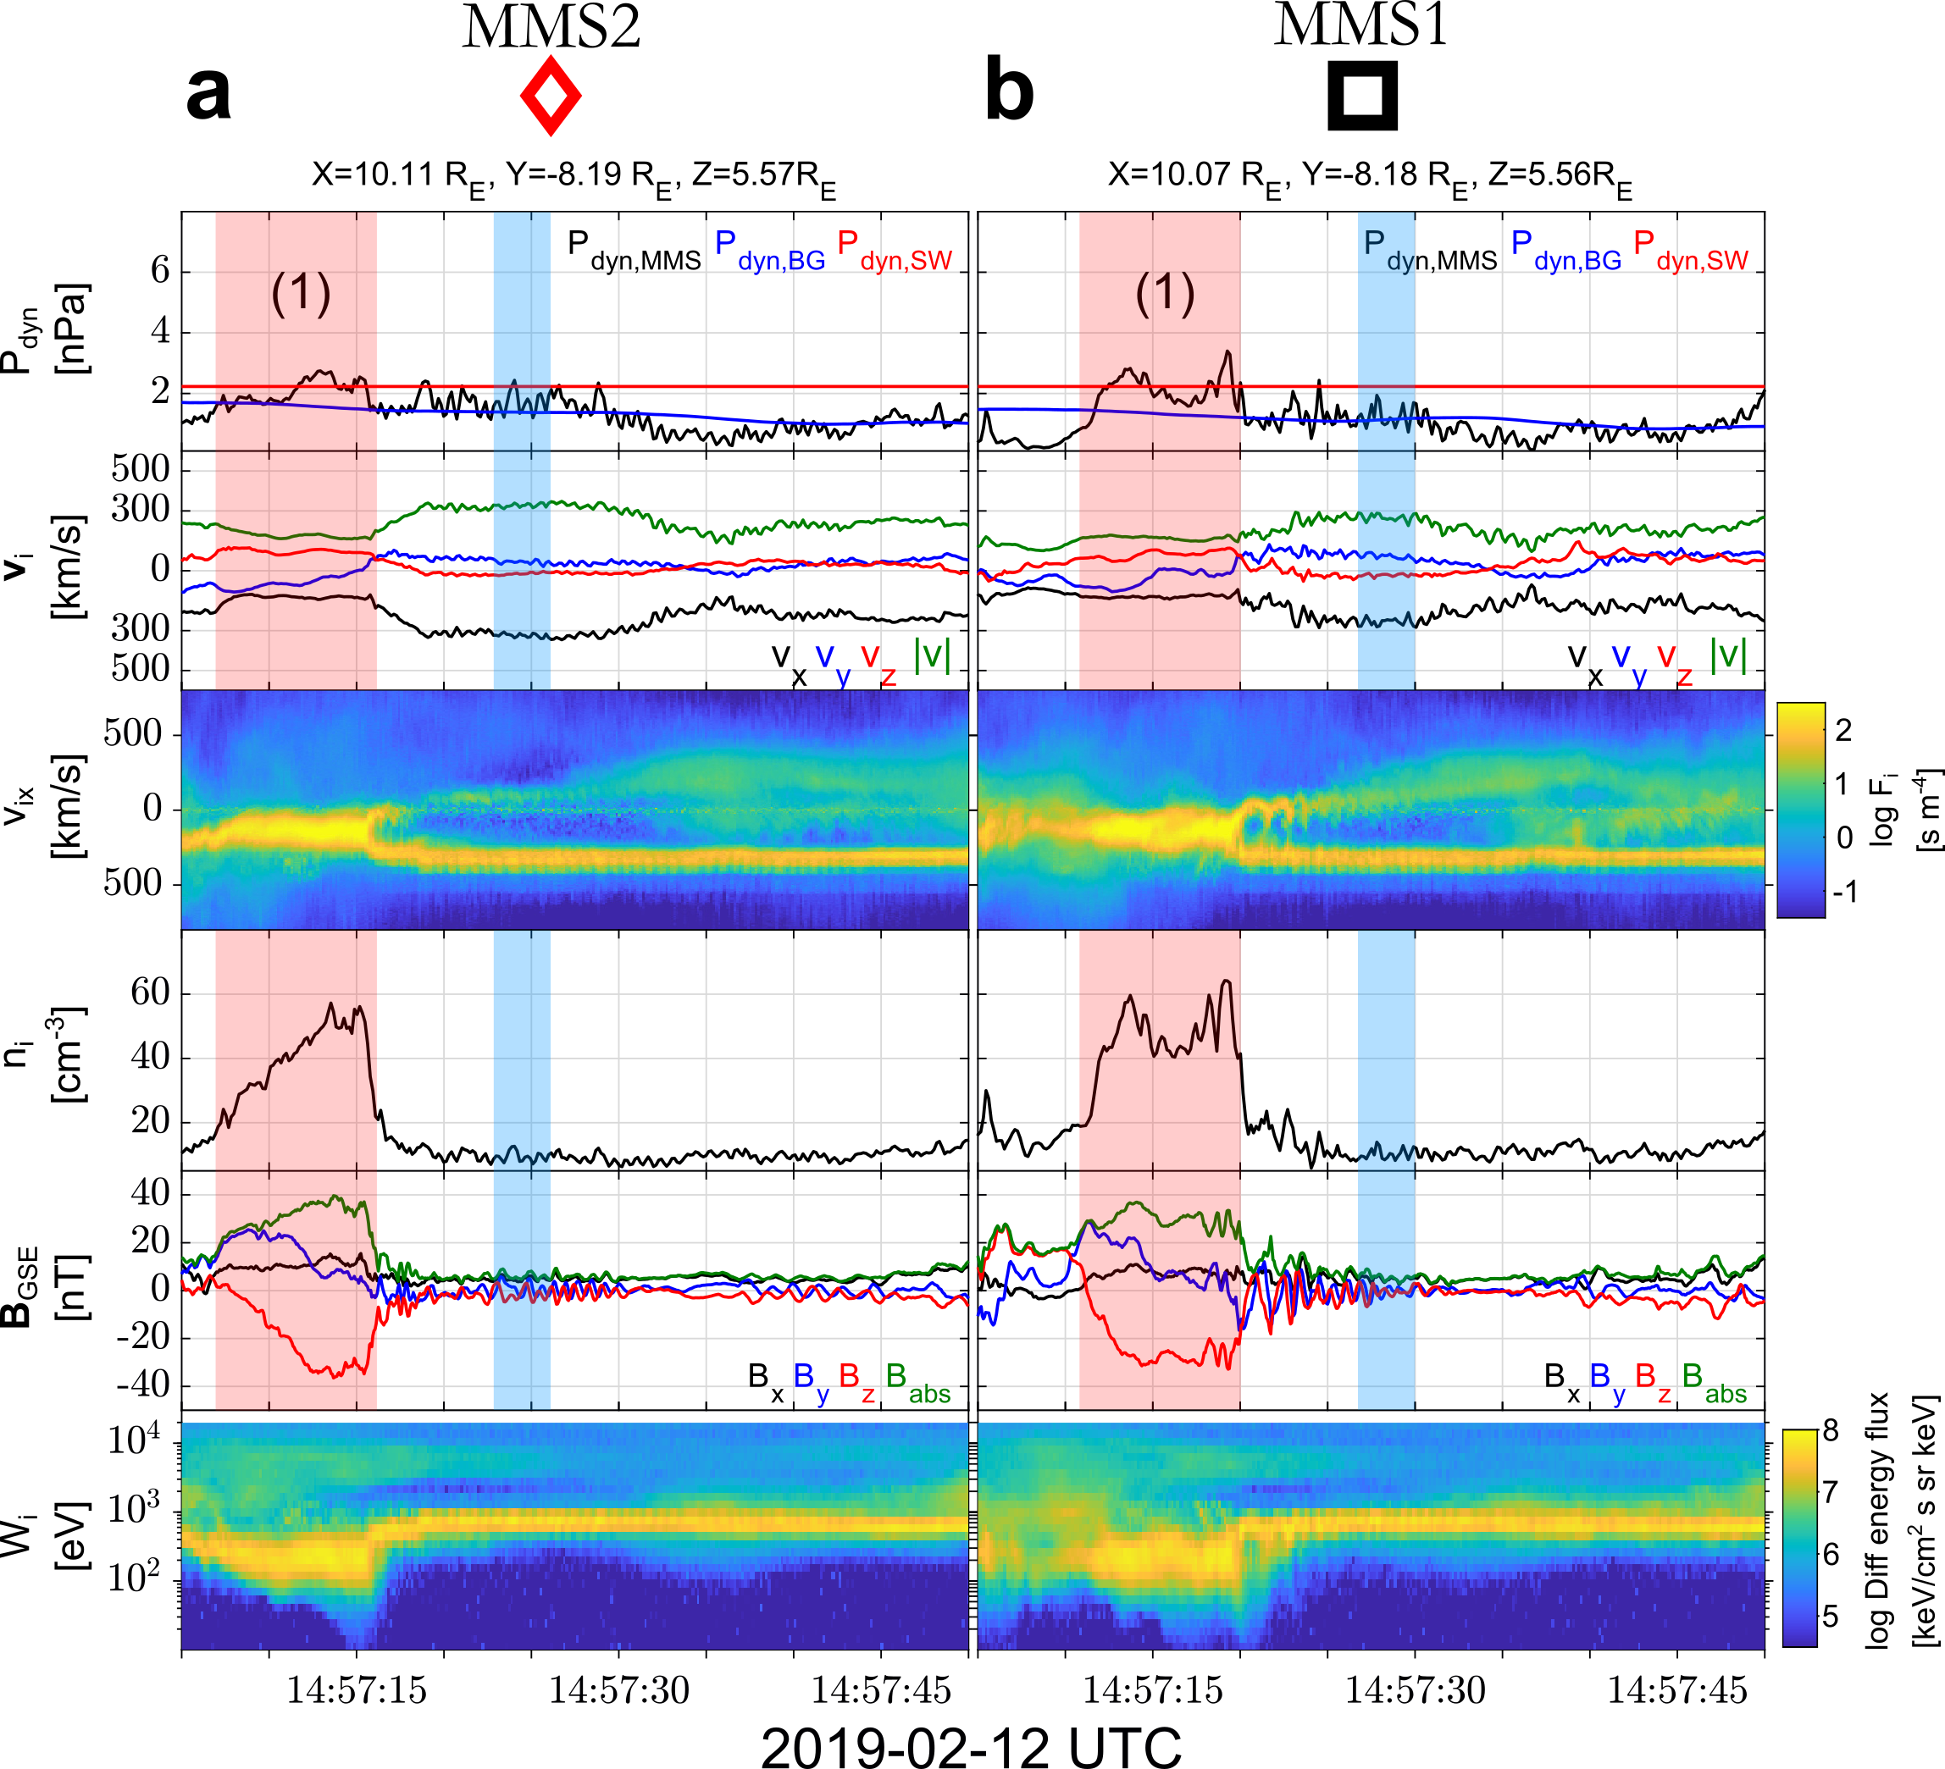

MMS outer-spacecraft observations

Slide 11
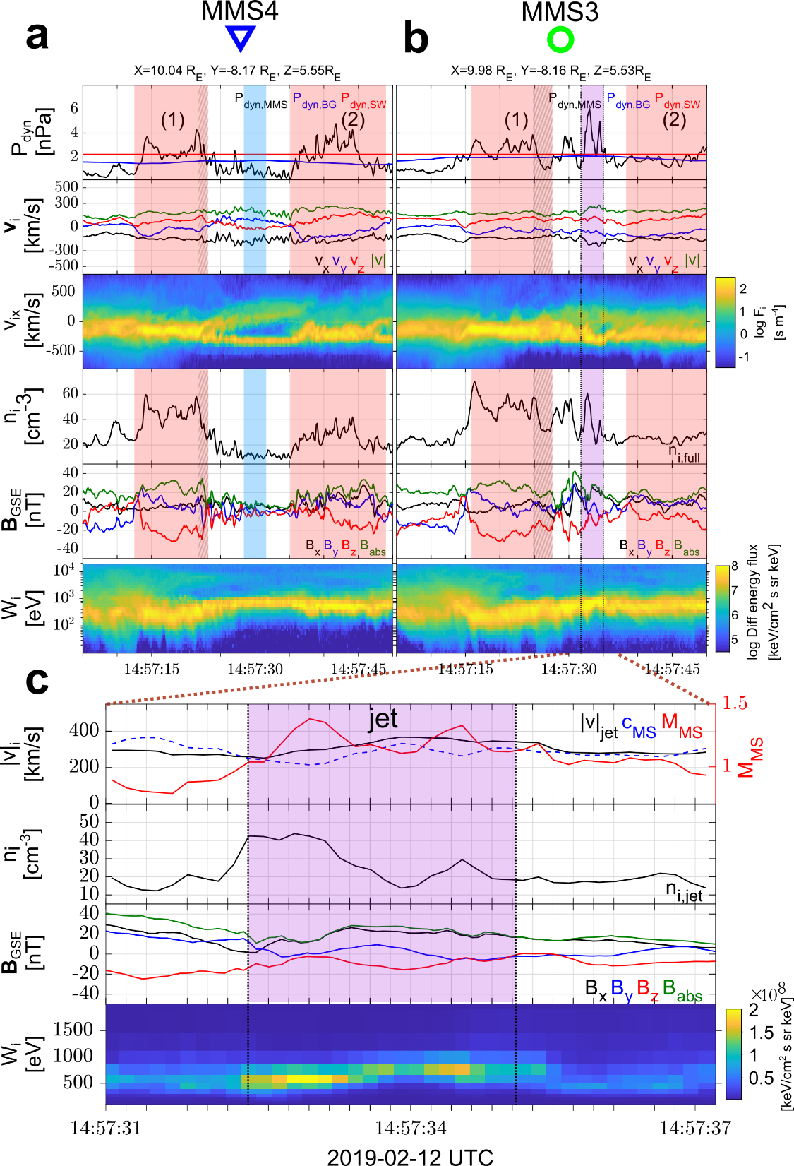
MMS inner-spacecraft observations

Slide 12
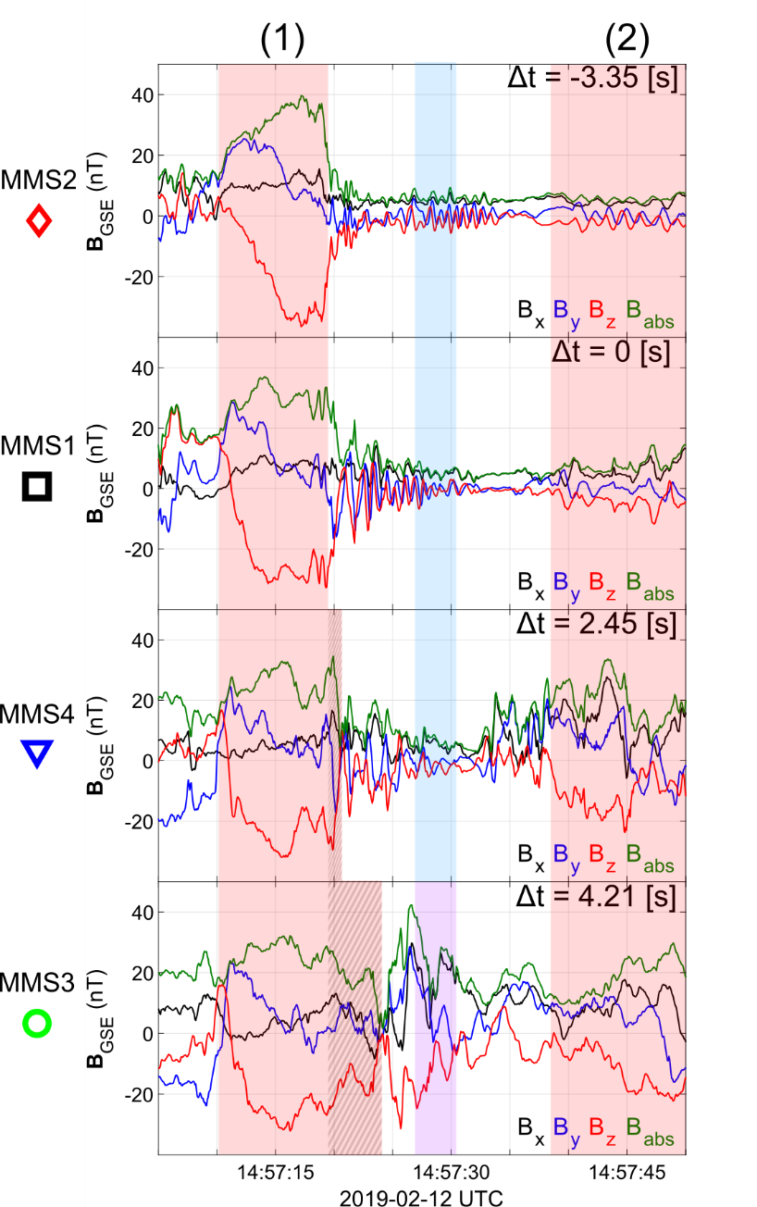
SLAMS & wave activity co-moving picture

Slide 13
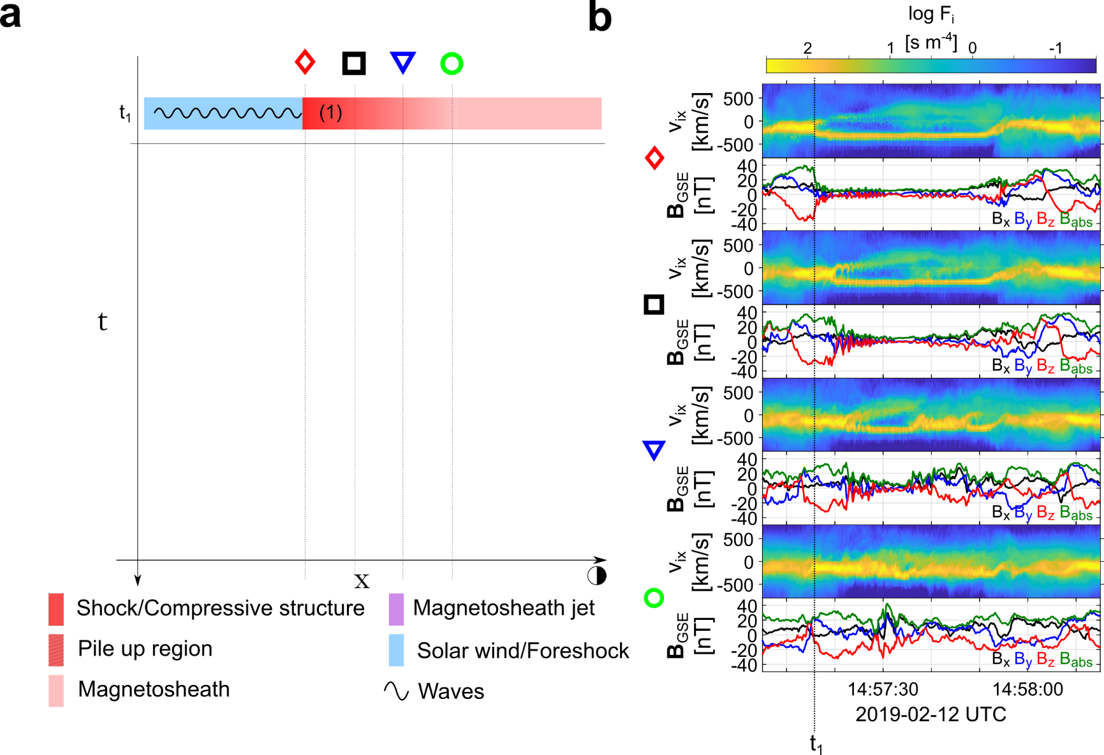
Formation mechanism

Slide 14
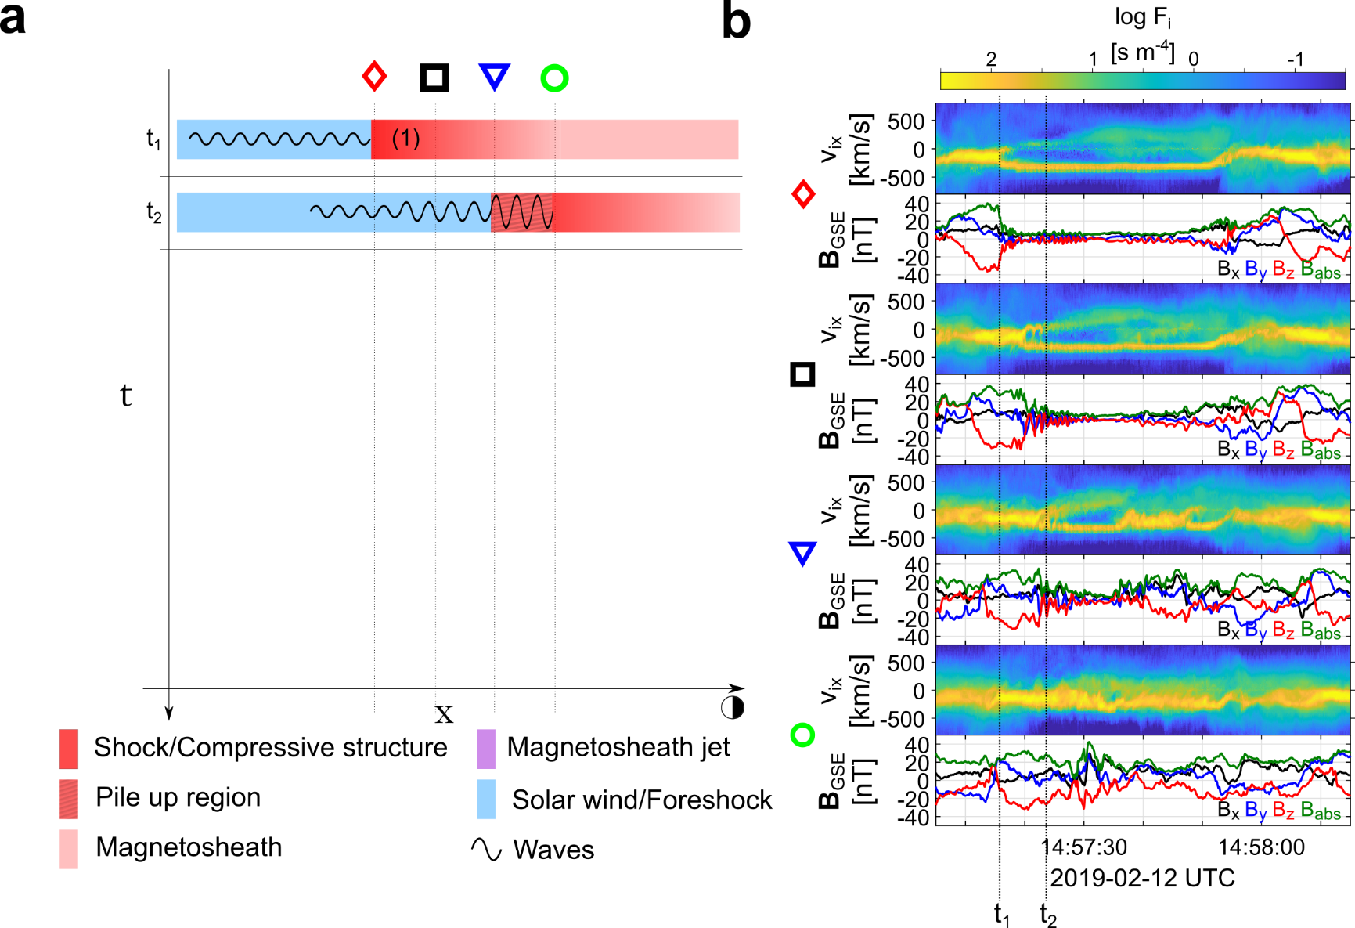
Formation mechanism

Slide 15
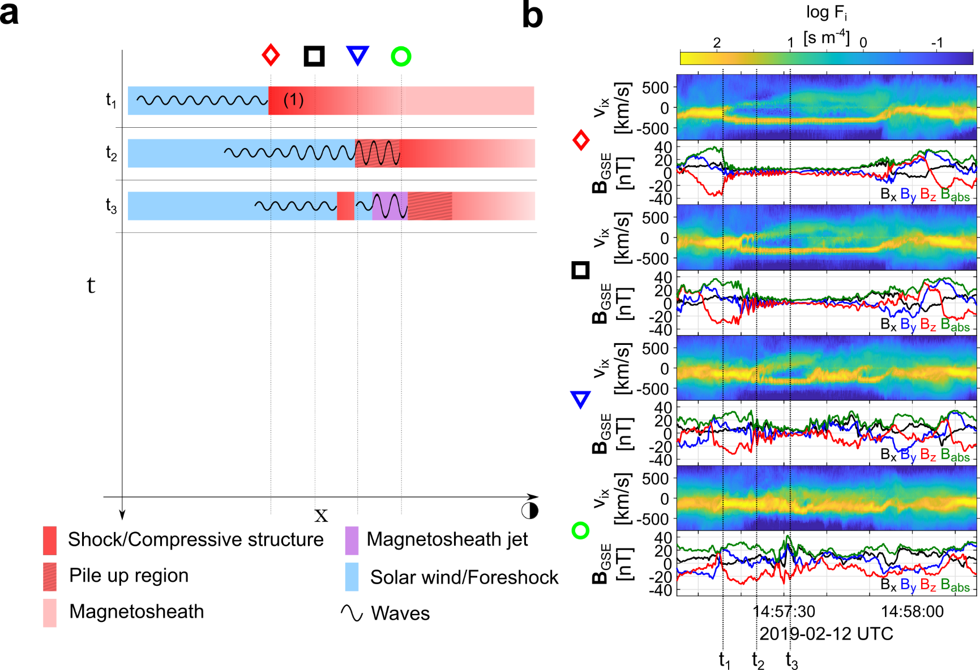
Formation mechanism

Slide 16
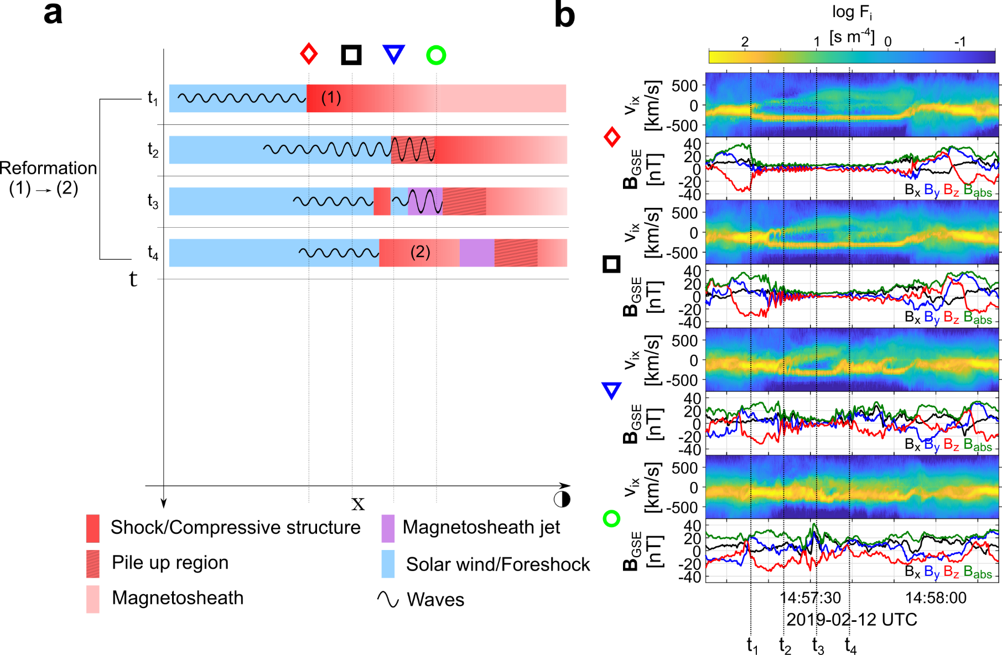
Formation mechanism

Slide 17
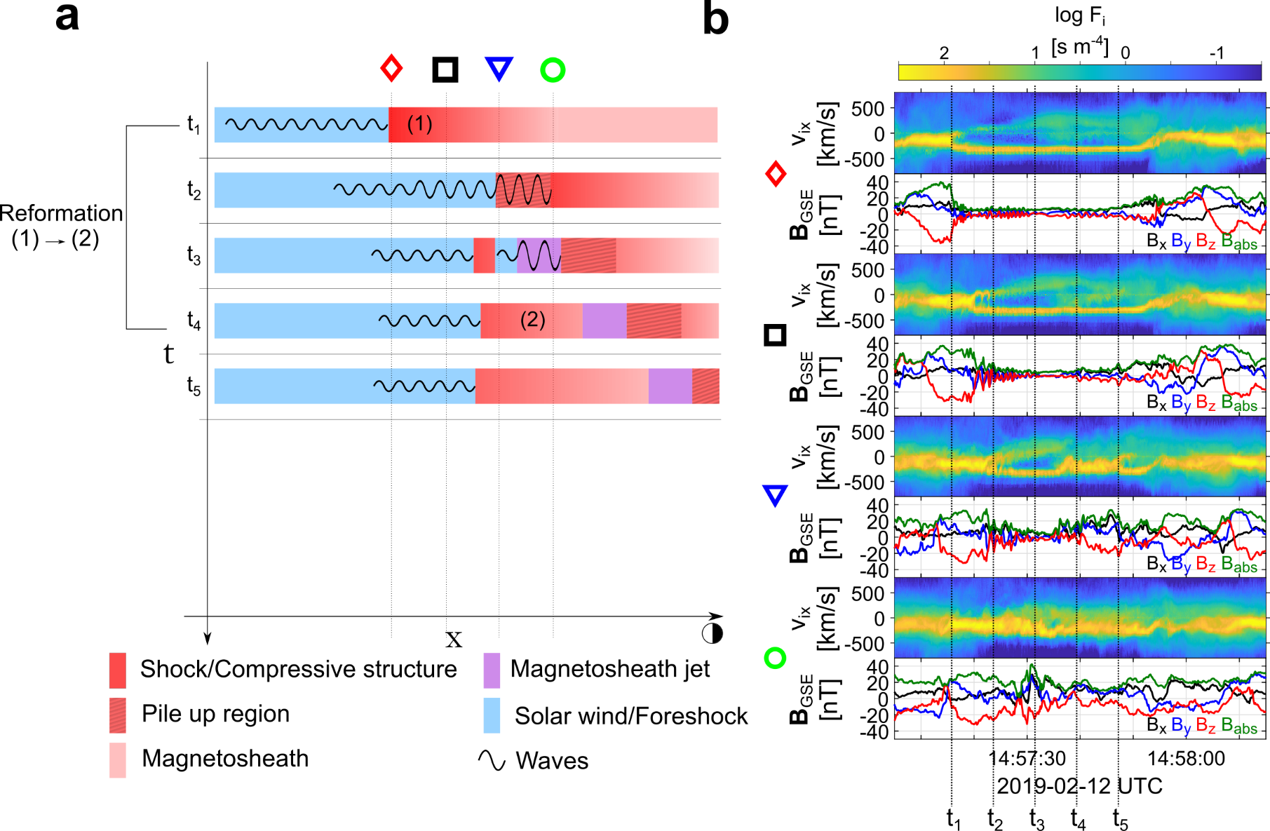
Formation mechanism

Slide 18
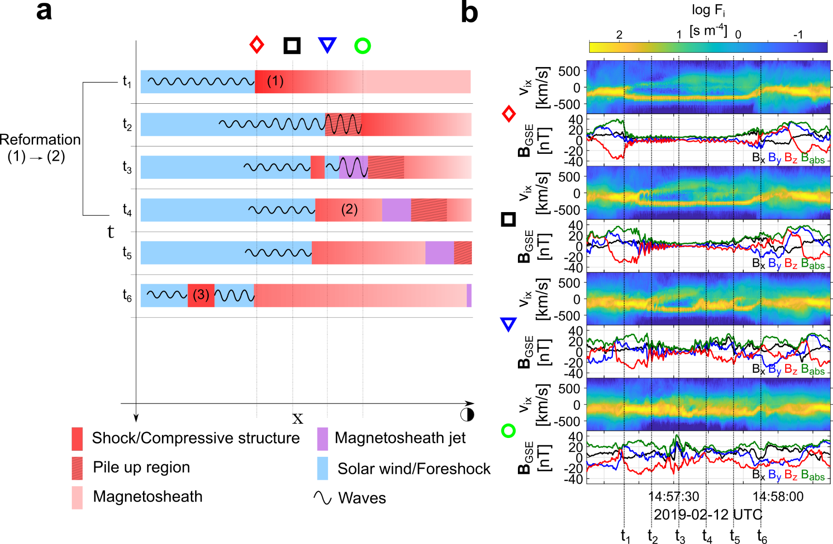
Formation mechanism

Slide 19
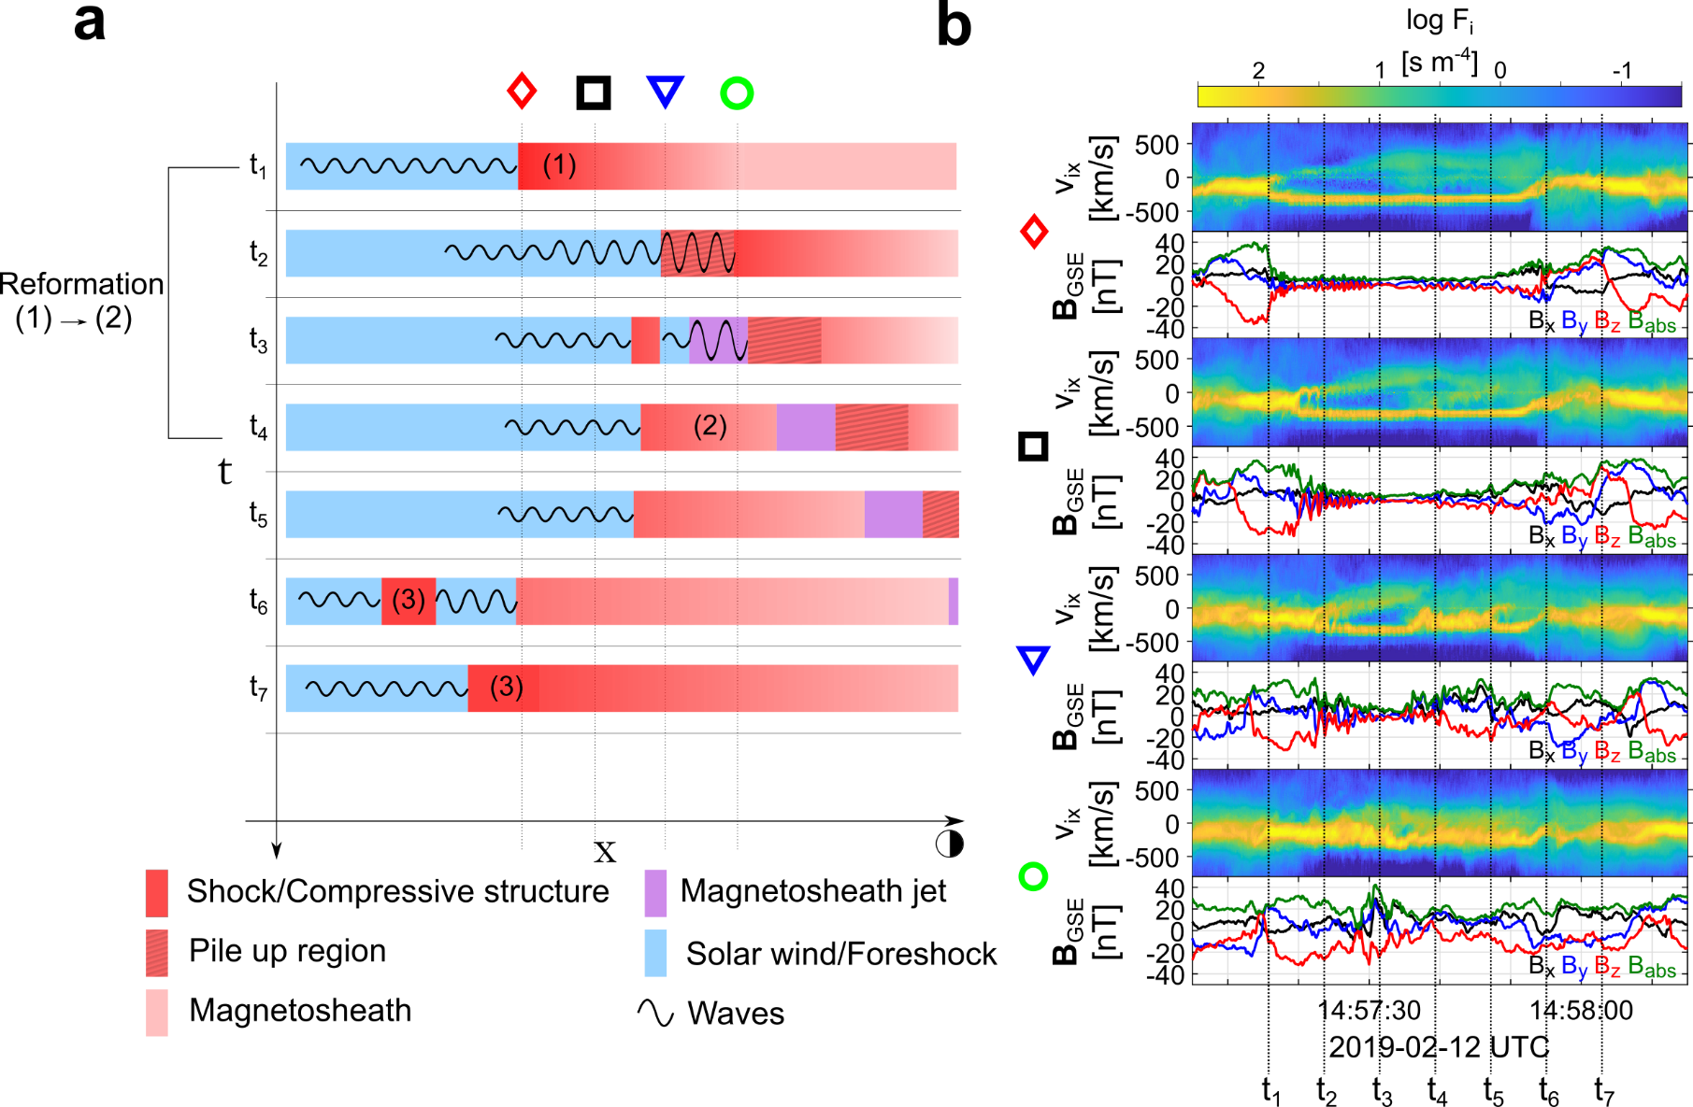
Formation mechanism

Slide 20
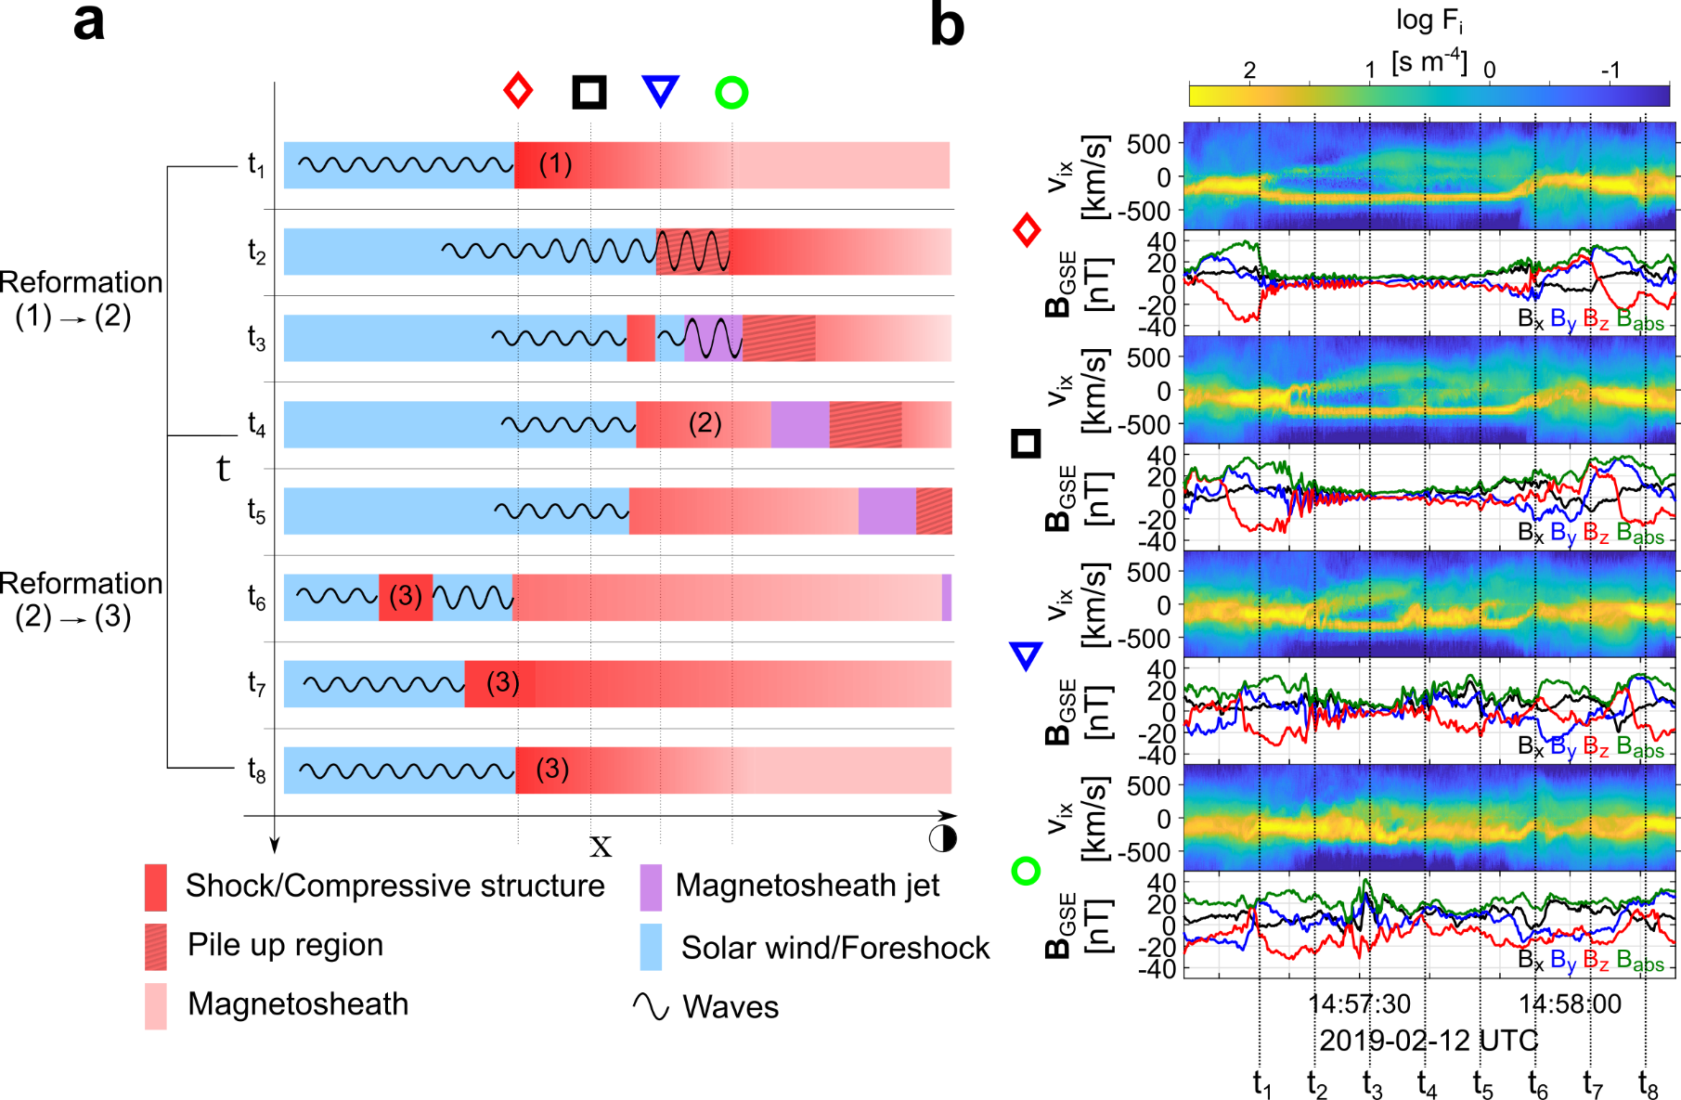
Formation mechanism

Slide 21


Summary & Conclusion
Main points
In-situ observations of shock fronts (SLAMS) becoming “embedded plasmoids” (density enhanced downstream regions).
in-situ observations of jets forming by the dynamical evolution of collisionless shock (reformation)
Implications
Possibly a general process of collisionless shocks that can be found in planetary, astrophysical and laboratory shocks.
Future work
Simulation comparison (connection with foreshock structures & reformation)
Statistics (need more events, currently found 3 of similar signatures)
Modeling (can this process explain jets close to MP ? Are these just a subset of small jets ?)

Slide 22
Extras

Slide 23
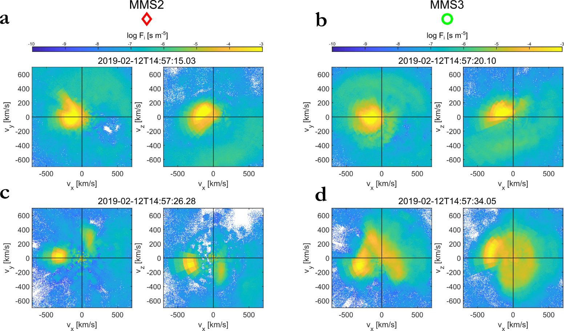
VDFs

Slide 24
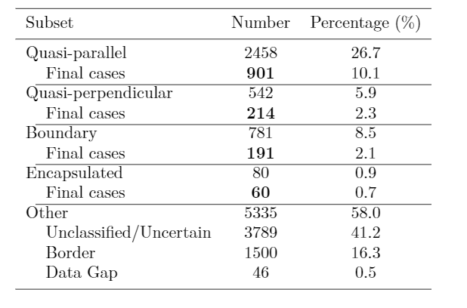
Jets database of MMS
Fast/Survey
Burst
9/2015 - 9/2020
Jets with full burst data
Qpar | 423
Qperp | 34
Boundary | 35
Encapsulated | 31
Close to BS / MP | 495
Others | 428
Useful to study early properties & generation
Raptis S., Karlsson T., et al. (2020) | JGR
Raptis S., Aminalragia-Giamini S., et al. (2020) | Frontiers
Palmroth M., Raptis S., et al. (2021) | Annales
Kajdic P., Raptis S., et al. (2021) | GRL
Raptis, Karlsson, et al. (2022) | Accepted
Raptis, Karlsson, et al. (2022) | Ongoing

Slide 25

Fast/Survey MMS data
Burst MMS data
Resolution (samples/s)
Resolution (samples/s)
FGM (magnetic field):
FPI (plasma moments | ions):
EDP (electric field):
0.0625
4.5
0.0313
0.0078
0.15
0.00012218
Pros
Always available
Decent resolution
Can be good for statistics due to availability
Pros
Very high resolution
Able to resolve structures close to boundary surfaces (e.g. mix of plasma close to magnetopause, bow shock, foreshock etc.)
Cons
Not available all the time, mostly available close to vital mission objectives (magnetopause, diffusion regions, shock transitions etc.)
Hard to do proper large scale statistics due to biases generated from specific availability and manual choice of intervals
Cons
Not suitable for small scale studies especially these related to ion moments
Could be misleading close to boundary surfaces (Magnetopause, Bow shock etc.) due to very similar observational signatures
More information: Baker, et al. (2016) | Space Sci Rev 19

Slide 26
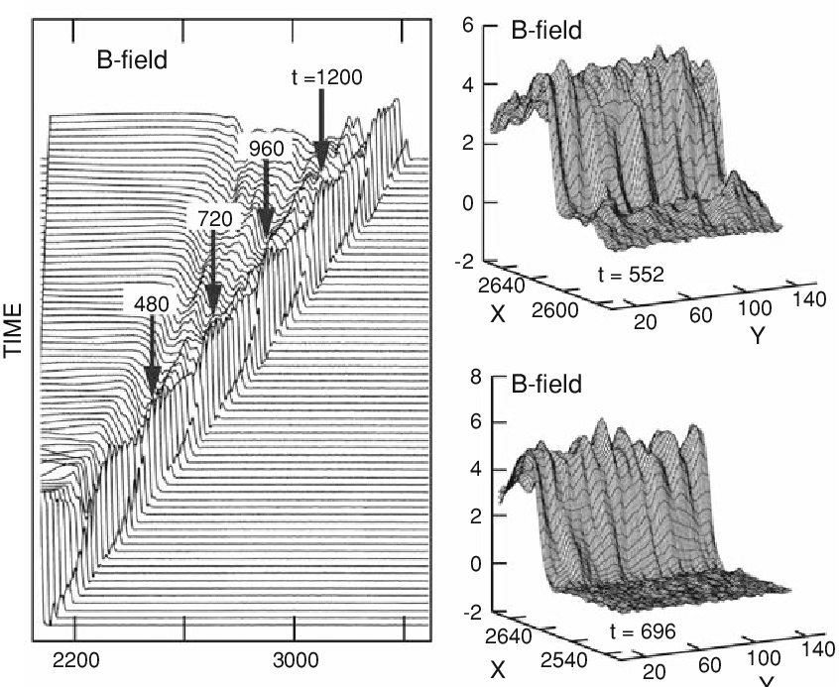
Shock Reformation idea
Lembège and Savoini 2002
Schwartz, 1990

